Slide 1
AI-Powered Job Recommendation System
Using Machine Learning for Skills-Based Career Matching
⬢
Syed Mohiuddin Mudassir
Candidate 415789 · MSc Computer Science
Supervisor: Dr. Paul Sant
Notes:
Introduce yourself: name, candidate number, project title, supervisor. One sentence on what you will cover: problem, solution, algorithm, evaluation, live demo.

Slide 2
The problem
Keyword search does not understand people
Graduate job boards still rely on keyword matching
A search for “Python” returns every posting that mentions Python – regardless of fit
Misses user intent, skills transferability and career progression
Candidates are overlooked; recruiters spend longer hiring
Research question
How can an AI-driven recommendation system improve job matching by understanding the connections between user skills, experience and job requirements?
Syed Mohiuddin Mudassir · 415789 · MSc Computer Science · AI-Powered Job Recommendation System
Notes:
Explain the limitations of keyword search with the Python example. Read the research question aloud.

Slide 3
The solution: JobRec
A web-based intelligent job recommendation engine – four objectives from the proposal
1 · Parse profiles
2 · Process postings with NLP
Skills, education and experience are normalised (“Power BI” → power_bi) and vectorised.
TF-IDF over title, skills and description of 8,000 real postings.
3 · Hybrid recommendations
4 · Evaluate accuracy
Content-based + collaborative filtering, blended with weight α; explainable results.
Precision@k, recall@k, hit-rate@k and NDCG@k on a held-out split.
Syed Mohiuddin Mudassir · 415789 · MSc Computer Science · AI-Powered Job Recommendation System
Notes:
Map the four cards to the four objectives in the proposal. Mention the stack: Python, pandas, scikit-learn, SciPy, Flask, SQLite.

Slide 4
The dataset
Kaggle – “Data Analyst Job Postings [Pay, Skills, Benefits]” (Luke Barousse, Google Jobs) – public postings only, no personal data
28,375
8,000
127
43%
raw postings
curated postings
annotated skills
remote roles
Merged 4 quarterly files → de-duplicated (20,446) → kept ≥ 2 skills (13,142) → sampled 8,000
Fields: title, company, location, description, schedule, remote flag, salary, skill list
data/prepare_dataset.py makes the process reproducible
Syed Mohiuddin Mudassir · 415789 · MSc Computer Science · AI-Powered Job Recommendation System
Notes:
Emphasise: proposal asked for ≥5,000 postings with skill annotations – delivered 8,000 with 127 skills. Ethics: only public postings.

Slide 5
How the recommender works
Hybrid = content-based filtering + collaborative filtering
User profile
skills · title · experience
Content-based
TF-IDF (8,000 × 40k) + cosine
½ text + ½ skill-set overlap
Hybrid score
α · content + (1 − α) · CF
α = 0.3 · cold start → content only
Interactions
view 1 · save 3 · apply 5
Collaborative
item-kNN cosine + TruncatedSVD
(40 latent factors)
Filters (location · remote · min salary) → top-k list with matched / missing skills for every job
Syed Mohiuddin Mudassir · 415789 · MSc Computer Science · AI-Powered Job Recommendation System
Notes:
Walk left to right. Content: TF-IDF + cosine + skill overlap. Collaborative: item-kNN and SVD (Koren, Bell & Volinsky 2009). Hybrid: weighted blend, alpha 0.3 by grid search, cold-start fallback. Every result is explainable.

Slide 6
Simulating users for collaborative filtering
Mock profiles for development – as stated in the proposal – real users only with consent in the evaluation phase
1 · Career tracks
2 · 300 users
3 · 4,213 interactions
K-Means clusters the 8,000 TF-IDF job vectors into 25 tracks (e.g. Power BI reporting, Python/Spark engineering, SAS/healthcare analytics).
Each user belongs to one track and gets 3–8 of that track's common skills plus a little noise, a target title and an experience sentence.
Each user views / saves / applies to 8–20 jobs in the track, with probability ∝ skill overlap. These are the ground truth for evaluation.
Syed Mohiuddin Mudassir · 415789 · MSc Computer Science · AI-Powered Job Recommendation System
Notes:
Be honest: users are simulated. Explain why the simulation is realistic (tracks + skill overlap) and that it is a stated limitation.

Slide 7
Evaluation: precision@k and recall@k
Per-user 70 / 30 split · 3,068 train / 1,145 held-out interactions · a hit = recommended job is in the held-out set
Syed Mohiuddin Mudassir · 415789 · MSc Computer Science · AI-Powered Job Recommendation System
Notes:
Hybrid is best at every k. Precision@10: popularity 0.011, content 0.018, collaborative 0.076, hybrid 0.089. Random ≈ 0.0005. Recall@20 hybrid 0.317.

Slide 8
Results at k = 10 and the choice of α
α = 1 pure content · α = 0 pure collaborative · best at α = 0.3
Model | Precision@10 | Recall@10 | Hit-rate@10 | NDCG@10
popularity | 0.011 | 0.026 | 0.077 | 0.020
content | 0.018 | 0.050 | 0.137 | 0.038
collaborative | 0.076 | 0.194 | 0.430 | 0.154
hybrid | 0.089 | 0.226 | 0.480 | 0.182
How to read the numbers
~3.8 relevant jobs per user among 8,000 → random precision@10 ≈ 0.0005. The hybrid is ≈ 8× popularity and ≈ 187× random. Hit-rate@10 = 0.48: 48% of users get a truly relevant job in their first 10 results.
Conclusion
Combining content and collaborative signals beats either alone – the project hypothesis is supported.
Syed Mohiuddin Mudassir · 415789 · MSc Computer Science · AI-Powered Job Recommendation System
Notes:
Explain why absolute precision is low in top-k evaluation and why the relative comparison matters. Alpha curve peaks at 0.3.

Slide 9
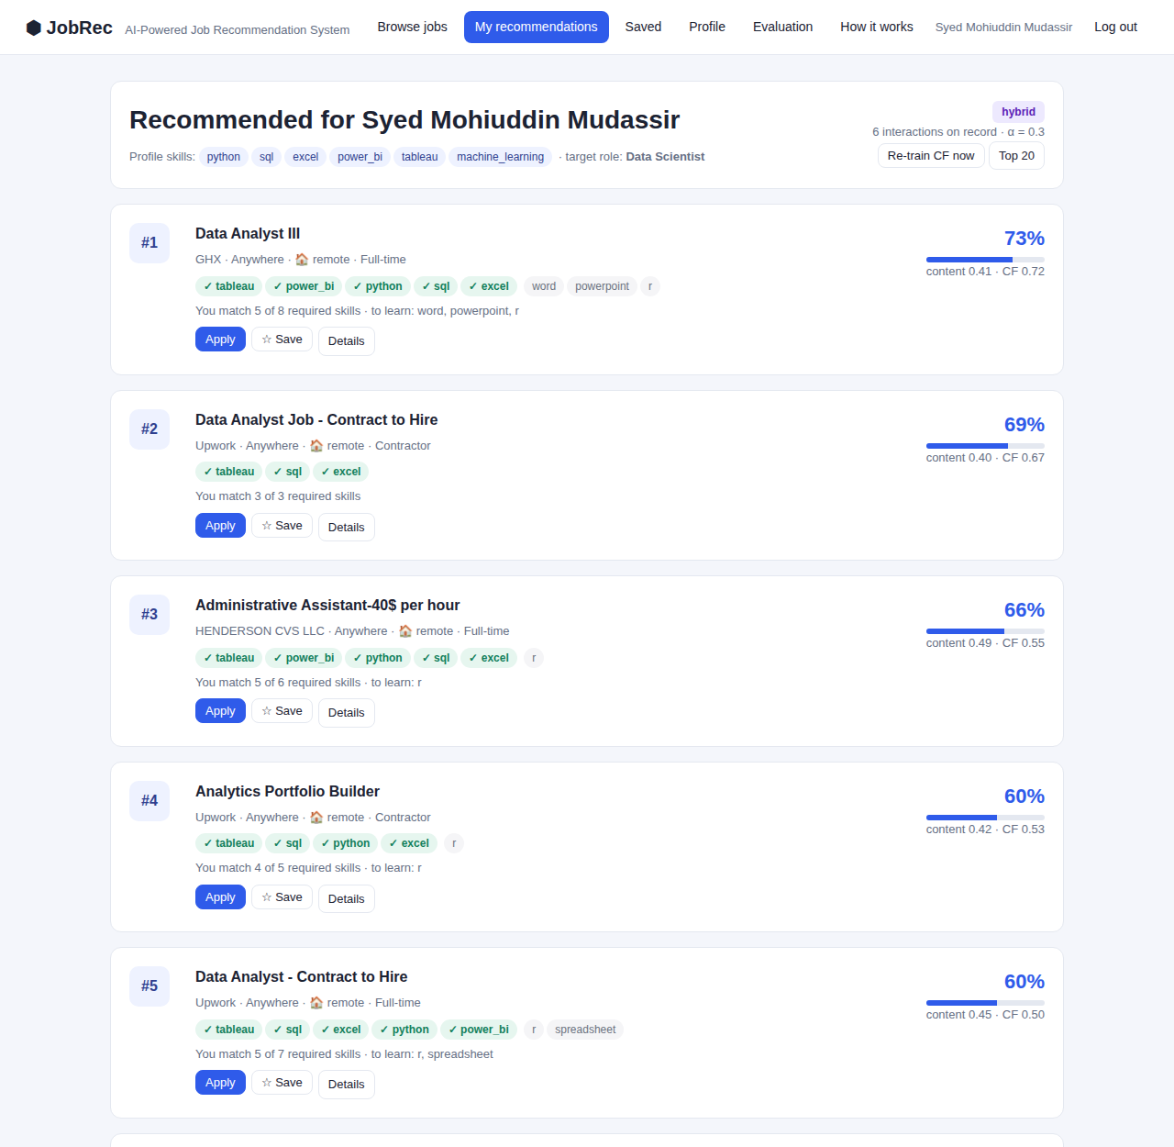
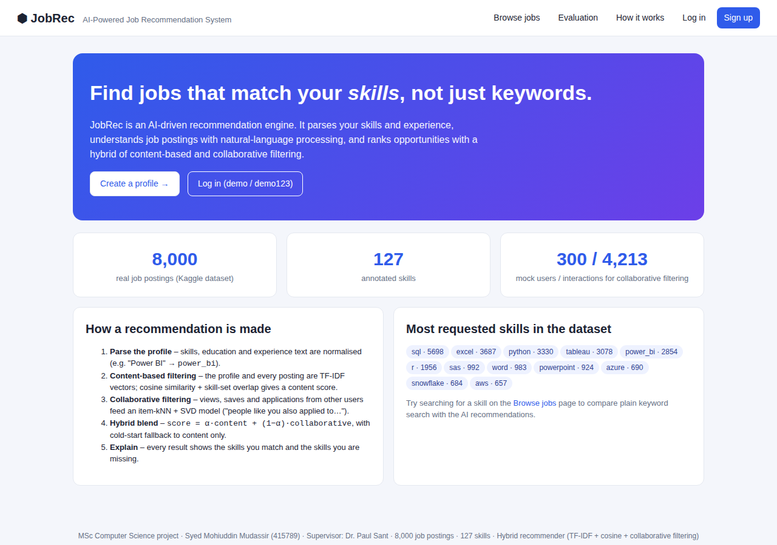
The web application
Flask + SQLite · authentication · profile · keyword search · explainable recommendations · REST API
Green ✓ = skills you match · grey = skills to learn
Badge shows “cold start” (content only) or “hybrid”
Each score shows its content and CF components
Save / Apply feed the CF model, which retrains every 5 interactions
Syed Mohiuddin Mudassir · 415789 · MSc Computer Science · AI-Powered Job Recommendation System
Notes:
Transition: 'Now let me show you the system running.' Switch to the browser for the live demo (see Part B of the presentation pack).

Slide 10
Live demonstration
About 5 minutes
1
Keyword search
2
New user (cold start)
3
Interact
Browse jobs → “tableau”: 3,000+ unordered results
Sign up, enter skills → content-only recommendations with explanations
Save / apply → interactions stored, CF retrains
4
Demo user (hybrid)
5
Filters
6
Evaluation page
demo / demo123 → hybrid badge, content + CF sub-scores
Remote only, minimum salary
Precision / recall tables, plot, α sweep
Syed Mohiuddin Mudassir · 415789 · MSc Computer Science · AI-Powered Job Recommendation System
Notes:
Follow Part B of the presentation pack step by step.

Slide 11
Limitations and future work
Limitations
Future work
• Collaborative model trained on simulated users – the 20-participant user study from the proposal is the next step
• Dataset is US-centric and analytics-focused
• TF-IDF cannot match synonyms (“dashboards” ≠ “data visualisation”)
• Popularity bias is possible in the CF component
• Add UK postings from Reed / Indeed
• Sentence-BERT embeddings instead of TF-IDF
• Implicit-feedback ALS or a two-tower neural recommender (Covington et al., 2016)
• A/B testing of click-through in production
• Deployment on PythonAnywhere / AWS free tier
Syed Mohiuddin Mudassir · 415789 · MSc Computer Science · AI-Powered Job Recommendation System
Notes:
Show critical awareness – examiners reward honest limitations tied to concrete next steps.

Slide 12
Summary
Curated 8,000-posting dataset with 127 annotated skills (Kaggle, public data only)
Python hybrid recommender: TF-IDF + cosine similarity + item-kNN / SVD collaborative filtering, α = 0.3
Flask web app with authentication, profiles, search, explainable recommendations, online retraining and REST API
Evaluation: hybrid precision@10 = 0.089, recall@20 = 0.317, hit-rate@10 = 0.48 – beats content, collaborative and popularity baselines
Thank you – questions?
Syed Mohiuddin Mudassir · 415789 · MSc Computer Science · AI-Powered Job Recommendation System
Notes:
Close with the summary and invite questions. See Part C of the presentation pack for likely questions.

